Slide 1

Machine Learning

Slide 2

Introduction to Machine Learning

Slide 3


Learning Objectives
By the end of this lesson, you will be able to:
Analyze the distinctions and applications of machine learning, deep
learning, and artificial intelligence through real-world examples for
various technical applications
Differentiate among various machine learning models and explore
how each model learns from data to predict outcomes
Explore Python libraries for effective data manipulation, visualization, and implementation of machine learning algorithms

Slide 4

Business Scenario
Example: YouTube Video Recommendations
Problem: YouTube wants to keep users engaged by suggesting videos they’ll enjoy watching.
Solution: YouTube uses Deep Learning, a type of machine learning, to analyze your activity and recommend videos.
How it works: - The system tracks what videos you watch or like.
It checks details about the videos, like titles, tags, and what’s trending globally.
For example, if you watch cooking videos, YouTube may suggest similar recipes or popular cooking channels.
It also considers what other users with similar interests are watching.
Result:You get a personalized feed of videos, helping you discover content you’ll enjoy, while YouTube increases its viewership and ad revenue.

Slide 5
What Is Machine Learning?

Slide 6

Machine Learning
It is a subset of artificial intelligence (AI) that assists systems to learn and improve automatically from
experience without being explicitly programmed.
Arthur Samuel coined the term machine learning (ML) in 1959.
It enables programs to learn automatically, making computers more intelligent without human intervention.

Slide 7
Traditional Approach Vs Machine Learning Approach
Traditional approach | Machine learning approach
Uses predefined rules and algorithms explicitly programmed by human developers | Learns from data to make predictions or take actions without being explicitly programmed
Relies on explicitly defined logic and rules to perform tasks | Uses statistical techniques and optimization algorithms to learn patterns and make decisions
Requires manual feature engineering, where relevant features must be identified and extracted by human experts | Automatically learns features from raw data, reducing the need for manual feature engineering
Faces challenges in handling complex and unstructured data without significant preprocessing | Handles complex and unstructured data, such as images, text, and audio, without requiring extensive preprocessing
Performance depends on the accuracy and completeness of the predefined rules and algorithms | Performance improves with more data and learning iterations, enhancing accuracy and generalization

Slide 8
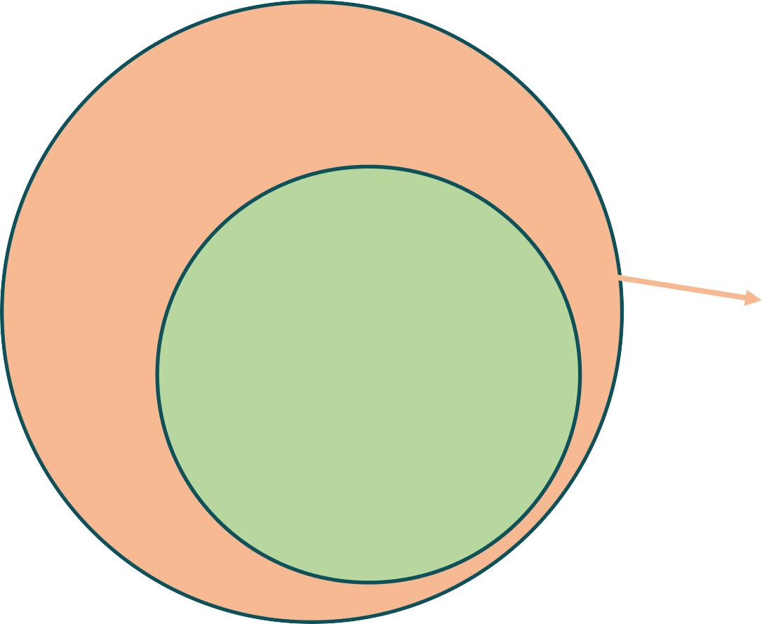
Difference Between ML, DL, and AI
Machine learning (ML), deep learning (DL), and artificial intelligence (AI) are often used interchangeably.
Artificial intelligence
It encompasses the simulation of human intelligence in machines.
Example: Self-driving cars
Machine learning
It is a subset of AI, which focuses on algorithms that
enable computers to learn from data.
Example: Amazon Alexa
Deep learning
It is a subset of ML that uses neural networks with multiple layers for complex pattern recognition, such as recognizing patterns in images, speech, and text.
Example: Handwriting recognition

Slide 9
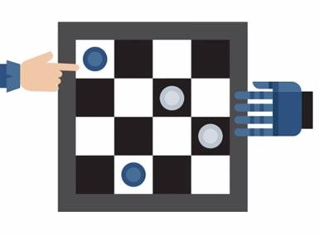
Machine Learning: Example
In a chess game between a computer and a person, the computer uses AI to analyze the game, predict moves, and decide its actions.
The AI uses machine learning to figure out if the opponent is a beginner, intermediate, or advanced player.
The AI decides its next move against the opponent using a complex neural network that learns various features and patterns from the data.

Slide 10


Applications of Machine Learning
There are many applications for machine learning, including the following:
Spam
filtering
Sentiment analysis
Social media analysis
Online recommendation systems
Customer service chatbots

Slide 11



Machine Learning Algorithms
These processes allow computers to learn patterns from data and make predictions on their own.
Machine learning algorithms help applications to:
Predict
outcomes
Classify the target feature
Improve the
performance

Slide 12
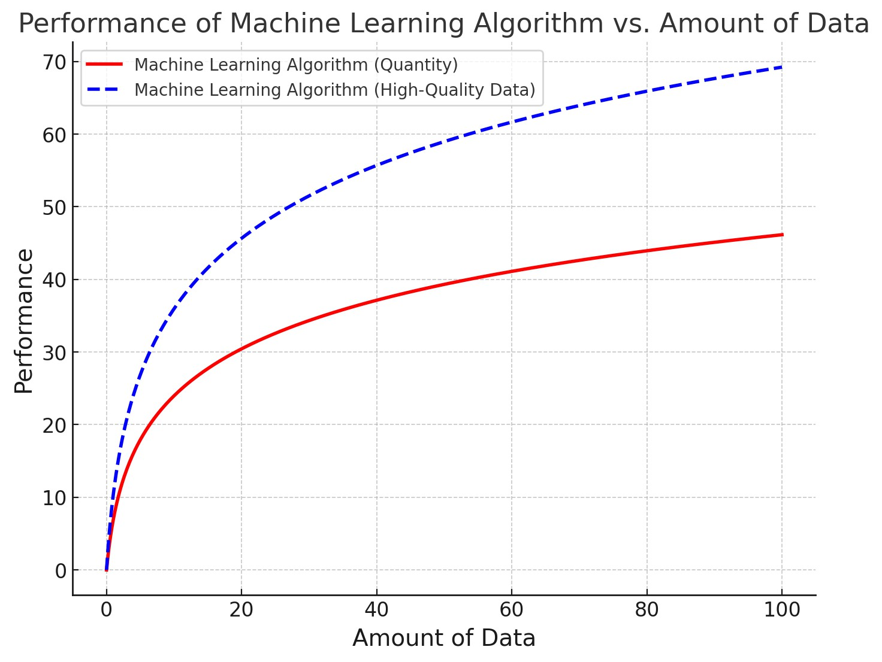
Data and Machine Learning Algorithms
The quality and quantity of the provided data evaluate the algorithm's performance.
High-quality and quantity of data is crucial for machine learning as it ensure better predictions and insights.
Source: https://academic.oup.com/nsr/article/10/7/nwad125/7147579

Slide 13
Steps in machine learning
1. Data Collection: Gathering raw information from sources like users, sensors, or websites. (Example: User watch history on YouTube or product purchases on Amazon.)
Representation: Organizing data into a format the machine can understand (like numbers, tables, or images). (Example: Turning video watch counts into numerical inputs.)
Modeling: Creating a machine learning model that finds patterns or relationships in the data. (Example: Building a system that links videos users like with similar ones.)
Estimation: Training the model to make predictions by finding the best-fit patterns in the data. (Example: Estimating which videos a user is most likely to watch next.)
Validation: Testing the model to ensure it works correctly with unseen data. (Example: Checking if the recommendations align with what users actually watch.)
Apply Learned Model to New “Test” Data:

Slide 14
Types of Machine Learning

Slide 15
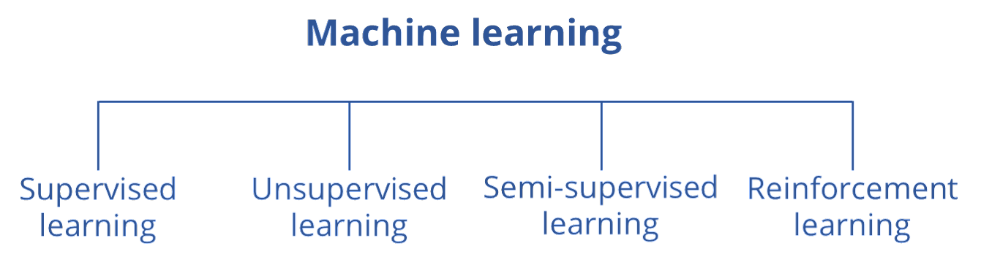
Types of Machine Learning
ML can be divided into four main categories; each characterized by its capacity to predict conditions or identify patterns to produce outcomes.

Slide 16
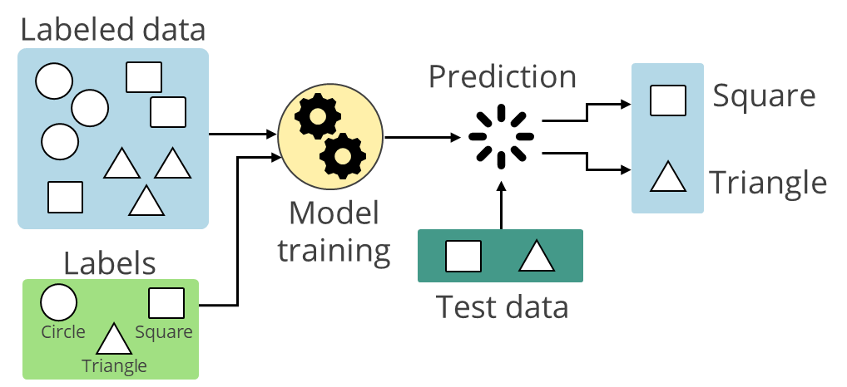
Supervised Learning
A supervised learning method uses labeled data to predict outcomes guided by specific input-output pairs.
Here, both inputs and outputs are known.

Slide 17
Supervised Learning Algorithms
Some commonly known supervised learning algorithms are:
Linear regression
Decision trees
Logistic regression
Support vector machines

Slide 18





Supervised Learning: Examples
Some examples of supervised learning are:
Predicting temperature rise based on yearly temperature trends
Predicting crop yield based on seasonal crop quality changes
Sorting waste based on known waste items and their corresponding waste types
In spam filtering, computers learn from labeled emails to decide if new emails are spam or not.

Slide 19
Unsupervised Learning
It allows models to identify patterns and structures in unlabeled data without explicit guidance.
Some examples are:
Image segmentation for object detection
Identification of user groups based on commonalities
Identification of anomalies over geographical landscapes based on the data patterns
The unlabeled dataset is provided to an unsupervised learning algorithm to discover hidden patterns and recognize their relationship.

Slide 20
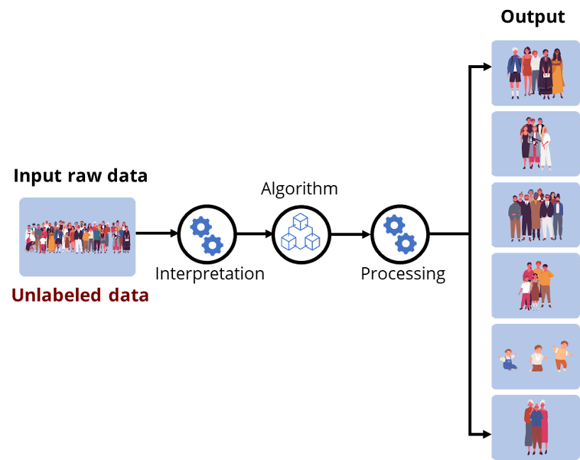
Unsupervised Learning: Example
It automatically groups images into distinct categories based on similarities, such as age group or
gender, without any prior labels.

Slide 21
Semi-Supervised Learning
It uses a combination of a small amount of labeled data and a large amount of unlabeled data for training.
Like supervised learning, it aims to learn a function that can accurately predict the output variable from the input variables.
It uses unlabeled input to assist the learning process by collecting more
information or improving model generalization.
Hence, it falls between supervised and unsupervised learning.

Slide 22
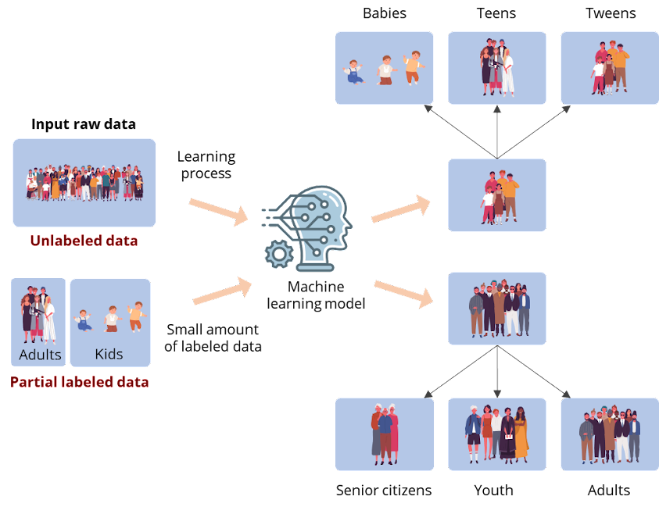
Semi-Supervised Learning: Example
This dataset contains both labeled and unlabeled data. Hence, semi-supervised learning is applied.

Slide 23


Semi-Supervised Learning: Example
Google Photos is a popular example of semi-supervised learning.
Whenever a picture is taken, it gets stored in the Google Cloud platform or a database.
In various instances, uploaders label images. Despite Google's lack of knowledge regarding image names, its algorithm can identify them by analyzing visual features like shapes and colors.

Slide 24
Reinforcement Learning
Reinforcement learning is a type of machine learning where algorithms learn from the environment by performing actions and receiving either rewards or penalties as feedback.
If the program finds the correct solution, the interpreter rewards the algorithm.
If the outcome is incorrect, the algorithm is penalized for incorrect predictions. It
must reiterate until it finds a better result.

Slide 25
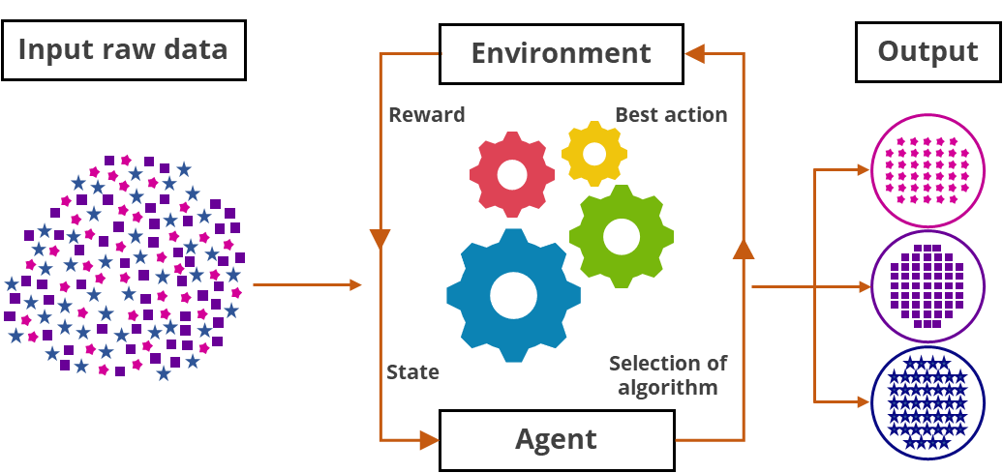
Reinforcement Learning
It involves an agent interacting with an environment, learning from rewards and states, to choose the
best actions and improve performance over time.

Slide 26

Reinforcement Learning: Example
This type of learning is best seen in YouTube recommendations, where a user searches for a particular song, and the program shows the list of available songs.
When the user selects a specific song, the system trains itself to remember and deliver a similar result for future searches based on user interactions, such as likes, views and shares.

Slide 27
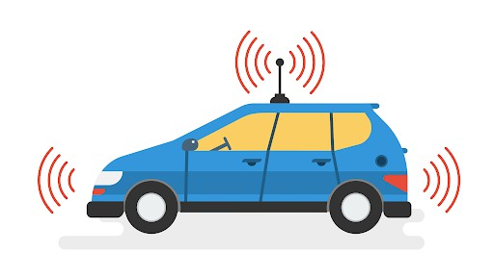



Reinforcement Learning: Examples
Examples of reinforcement learning include:
Games where players can play with bots
Self-driving cars
Autocorrect tools
Search recommendation engines

Slide 28
Introduction to Python Packages for Machine Learning

Slide 29



Python Libraries Used in Machine Learning
Some Python libraries used in machine learning include:
NumPy is a powerful library for numerical computing in Python.
Matplotlib performs data visualization and graphical plotting.
Pandas is a versatile data manipulation library in Python, offering data structures like DataFrames.

Slide 30


Python Libraries Used in Machine Learning
Some Python libraries used in machine learning are:
SciPy solves mathematical equations and processes algorithms.
Scikit-learn offers efficient versions of common algorithms, facilitating the development of machine learning models.

Slide 31

Key Takeaways
Machine learning refers to a machine's ability to learn from data and replicate human behavior.
AI includes machine learning and deep learning, each with unique capabilities for simulating intelligence.
There are four main types of machine learning: supervised learning, unsupervised learning, semi-supervised learning, and reinforcement learning.
Python packages are folders with modules that organize code for easy reuse and maintenance, improving development efficiency.

Slide 32
Thank You

